Slide 1


Literary Criticism
(BA-TY)
Dr. Nirmala S. Padmavat
Director, IQAC
Nutan Mahavidyalaya, Selu

Slide 2
Ben Jonson:
Early life Literary Work
Ben Jonson, an influential English playwright, poet, and literary critic of the Renaissance era, lived from 1572 to 1637. He expressed his thoughts on literary criticism in various works, including prefaces, dedications, and essays. Ben Jonson was born on June 11, 1572, in Westminster, London, to a clergyman father and a mother from a prominent landowning family. His formal education was at Westminster School, where he received a classical education, studying Latin and the classics. He briefly attended Cambridge University but left without obtaining a degree due to financial constraints. Jonson joined the military and served as a volunteer soldier in the Low Countries (now Belgium and the Netherlands) during the Eighty Years' War.

Slide 3
Literary Work
Jonson is best known for his plays, which were a significant part of the Jacobean theatre scene. His first major success as a playwright came with the play "Every Man in His Humour" (1598), which established him as a leading figure in the London theatre world. Jonson was known for his collaboration with the company of actors known as the "Lord Chamberlain's Men" (later renamed the "King's Men"), which included William Shakespeare as a member.
He wrote several comedies, tragedies, and masques (courtly entertainments) that showcased his wit, classical learning, and keen observations of contemporary London society.

Slide 4
Notable Plays
"Volpone" (1606): A satirical comedy that criticizes greed and corruption in society.
"Epicoene, or The Silent Woman" (1609): A comedy that humorously portrays a character pretending to be a woman.
"The Alchemist" (1610): A satirical comedy that ridicules alchemy and con artistry. "Bartholomew Fair" (1614): A lively and raucous comedy set in the context of a fair.

Slide 5



Poetry
Jonson was also a skilled poet, and his poetry included elegies, epigrams, and other forms. He was known for his craftsmanship and mastery of various poetic styles. His most famous poem is "To Penshurst," a celebration of the country estate of the Sidney family, which demonstrates his fondness for classical traditions and nature.

Slide 6

Literary Criticism
Jonson was one of the first English writers to engage in formal literary criticism. His influential essay, "Discoveries," offers insights into various literary and artistic topics. In "Discoveries," Jonson critiques his contemporaries, discusses the role of the poet, and emphasizes the importance of imitation and study of classical writers. One of the most notable pieces of his literary criticism is his work titled "Discoveries," also known as "Timber," which is a collection of notes and observations on various literary and artistic topics. Here are some key points from Jonson's literary criticism:

Slide 7
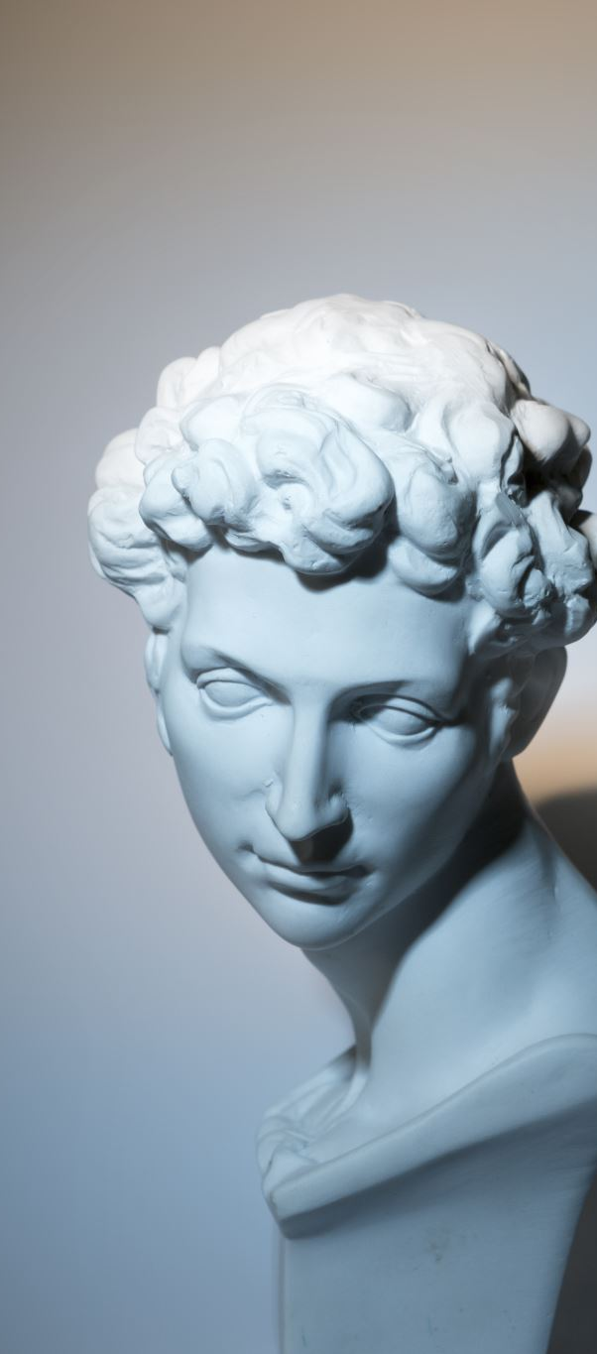
Classicism and Ancient Models
Jonson was a strong advocate of classicism and believed that the works of ancient Greek and Roman writers, such as Aristotle, Horace, and Plutarch, provided excellent models for literary composition. He admired the discipline and structure of classical literature and encouraged writers to emulate these models.

Slide 8

Importance of Learning and Knowledge
Jonson valued learning and scholarship, and he believed that a writer should be well-versed in various disciplines, such as history, philosophy, and languages. He saw knowledge as essential for enriching one's writing and achieving excellence in the craft.

Slide 9

Distinction between "Art" and "Nature"
Jonson discussed the difference between artifice (art) and nature in writing. He argued that a successful writer should strike a balance between creative imagination (art) and an authentic portrayal of human behavior and emotions (nature) to create believable and compelling characters.

Slide 10

Verisimilitude and Realism
Jonson emphasized the importance of verisimilitude, or the appearance of truth, in literature. He believed that a work of fiction should be grounded in realism, and the characters should be believable and relatable to the audience.

Slide 11

Comedy and Satire
Jonson was known for his comedic plays and satirical works. He valued the role of comedy in highlighting human foibles and vices, aiming to correct and improve society through laughter and critique. He saw satire as a powerful means of social commentary.

Slide 12
Role of the Poet
Jonson believed that a poet or writer should be a master of their craft, possessing a deep understanding of language, meter, and rhetorical techniques. He saw the poet as a figure with great responsibility, as their words could influence and impact society.

Slide 13

Critique of Contemporary Writers
In "Discoveries," Jonson occasionally criticized the works of his contemporaries, both playwrights and poets. He offered candid assessments of their strengths and weaknesses, often comparing them to the classical writers he admired.

Slide 14

Moral Function of Literature
Jonson saw literature as a vehicle for moral instruction and edification. He believed that art should serve a higher purpose and contribute to the moral improvement of society.

Slide 15

Conclusion
Ben Jonson's literary criticism, particularly his adherence to classical principles, his emphasis on learning, and his belief in the moral power of literature, had a significant influence on subsequent generations of writers and contributed to the development of English literary traditions. His "Discoveries" remains an important text for understanding the literary ideals and principles of the English Renaissance.

Slide 16

Thank you!

